Slide 1
Exception Handling

Slide 2
Objectives
At the end of this session, the participants will be able to:
Understand the concept of Exceptions
Comprehend the difference between system and user-defined exceptions
Handle system and user-defined exceptions in PL/SQL block
Understand the rules for Exception Propagation

Slide 3
Agenda
What is an exception?
Why exception handling is needed?
Handling Oracle predefined (named), non-predefined (unnamed) and user-defined exceptions
Using SQLERRM and SQL_CODE
Handling unnamed exceptions using pragma EXCEPTION_INIT
Propagation of exceptions, raised in different parts of a PL/SQL block (nested blocks) with examples

Slide 4
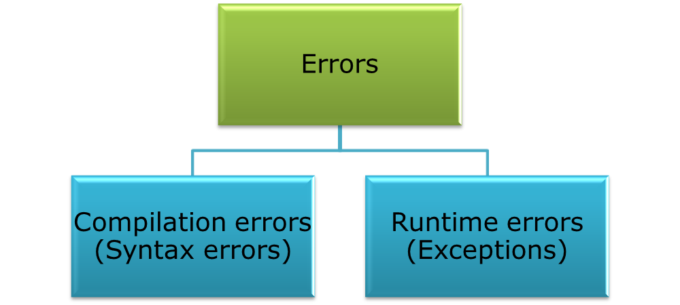

Errors
An exception is an Error situation which may arise during program execution.
Notes:
You have two types of errors: compilation errors and run-time errors. Compilation errors occur when you make an error typing the program or defining the program. The typing errors include forgetting a reserved word, keyword, or semicolon. These lexical errors are caught when the plain text file is parsed during compilation. Parsing is the process of reading a text file to ensure that it meets the lexical usage rules of a programming language. Run-time errors occur when actual data fails to meet the rules defined by your program unit.

Slide 5
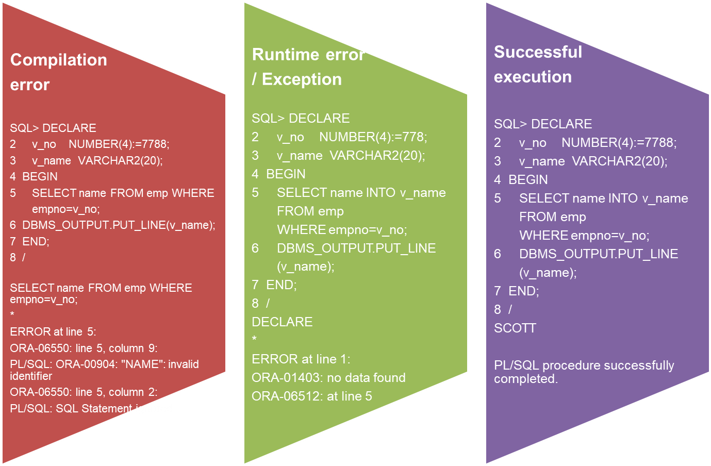
Understanding Exceptions
Notes:
All compilation errors are thrown back to the session and cannot be handled by your local exception handler, but you can catch them in a wrapper (containing outer) block.
Run-time execution errors can always be caught and processed by the local or external
exception block. Run-time errors in exception blocks can only be caught by an outer block
exception handler. You can also opt not to catch errors and have them thrown back to the
originating SQL*Plus session.

Slide 6
Understanding Exception
In PL/SQL, run time error condition is called an exception
When an exception occurs a messages which explains its cause is received.
PL/SQL Exception message consists of three parts:
    Type of Exception
    An Error Code
    An Error message

Slide 7
Exception Handling in PL/SQL
An Exception Handling section in a PL/SQL block handles the runtime errors or also referred to as exceptions.
It allows programmers to specify what actions should be taken when a specific exception occurs
IS
BEGIN
EXCEPTION
END;
Header (named blocks only)
Declare Section
Execution Section
Exception Section
Notes:
Exceptions (PL/SQL runtime errors) can arise from design faults, coding mistakes, hardware failures, and many other sources. You cannot anticipate all possible exceptions, but you can write exception handlers that let your program to continue to operate in their presence.
Although you cannot anticipate all possible errors, you can plan to handle certain kinds of errors meaningful to your PL/SQL program. PL/SQL provides you a flexible and powerful way to handle exceptions.
Each PL/SQL block can have its own exception section (optional), in which exceptions can be trapped and handled (resolved or passed on to the enclosing block). To handle raised exceptions, you write separate routines called exception handlers
Every exception in PL/SQL has an error number and error message; some exceptions also have names.

Slide 8
Exception Handling in PL/SQL
PLSQL supports Oracle named (predefined) and unnamed (not predefined) exceptions as well as user-defined exceptions
In any type of Exception, when the exception takes place the exception is said to be “RAISED”
An Exception Handler is used to specify the response for a raised exception

Slide 9

Exception Handling in PL/SQL (Contd.)
When an exception is raised, either implicitly or explicitly, the normal execution of the program is abandoned
The control then shifts to the corresponding exception handler if it is present else control shifts to the calling environment
In any case, when an exception is fired then the control can not return to the executable section of the current block
If an exception is handled then the program unit is considered as successful ie. the effect of the operations performed before the exception is raised, is saved else the earlier operations are rolled back.
Is the exception trapped?
Terminate abruptly
No
Exception is raised
Propogate the exception.
Yes
Execute statements in the EXCEPTION section
Terminate gracefully
Notes:
When an exception is raised, in a PL/SQL block,
1. Execution section of that block immediately terminates.
2. Control is passed to the exception section (if it exists).
3. Exception handler get executed.
Note:
When an exception is raised, the control cannot return to the executable section of the current block i.e. the remaining statements are not executed.
If an exception is handled, the program unit is considered as successful i.e. the effect of the operations performed before the exception is raised, is saved else the earlier operations are rolled back.

Slide 10
Types of Exceptions
Named Exceptions | Unnamed Exceptions | User-defined Exceptions
Set of Oracle standard exceptions that are already named | Set of Oracle standard exceptions that are not given name | A condition that the developer determines is abnormal
Do not declare and allow the Oracle server to raise them implicitly | Declare within the declarative section. Associate an exception name with an Oracle error number and allow Oracle to raise them implicitly. | Declare within the declarative section and raise explicitly
Notes:
a) Named Exceptions:
The exceptions which are already given names by Oracle are declared in the STANDARD package in PL/SQL. You do not have to declare them in your own programs. You only need to handle them.
Oracle Exception Name - Oracle Error - Explanation
1.NO_DATA_FOUND ORA-01403 - You executed a SELECT INTO statement and no rows were returned.
2. TOO_MANY_ROWS ORA-01422 -You tried to execute a SELECT INTO statement and more than one row was returned.
3. ZERO_DIVIDE ORA-01476 -You tried to divide a number by zero.
4. INVALID_NUMBER ORA-01722 -You tried to execute an SQL statement that tried to convert a string to a number, but it was unsuccessful.
5.. VALUE_ERROR ORA-06502 -You tried to perform an operation and there was a error on a conversion, truncation, or invalid constraining of numeric or character data.
6. CURSOR_ALREADY_OPEN ORA-06511 -You tried to open a cursor that is already open
b) unnamed Exceptions:
It is used to trap an internal error raised by PL/SQL or the SQL engine, which is not been given a predefined name. Although this error is identified only by its internal error number, exception handlers need a name by which they can check for a match .The following are some of the unnamed exceptions which don’t have standard Oracle names but the names can be created and assigned with the error number by the user by using PRAGMA EXCEPTION_INIT
1. ORA-00001: unique constraint (SCOTT.SYS_C003701) violated - raised when trying to put a duplicate value in a column that has UNIQUE / PRIMARY KEY constraint
2. ORA-02292: integrity constraint (SCOTT.SYS_C003731) violated - child record Found – raised when trying to delete a parent record that has child records and while setting the referential integrity constraint in the referencing table no “ON DELETE” clause used

Slide 11
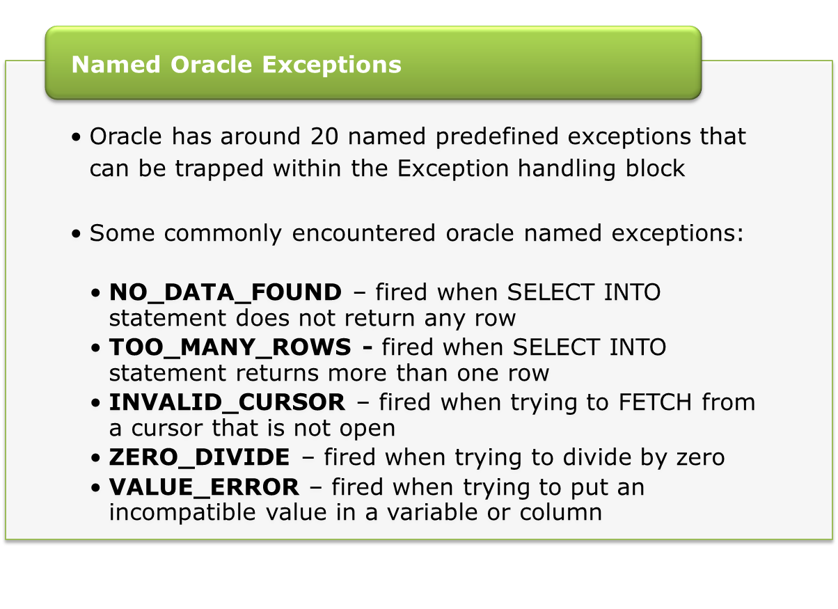
Exception Handling in PL/SQL

Slide 12
Raising an Exception
An exception is raised implicitly if any Oracle error occurs e. g. when no rows are retrieved by SELECT statement, PL/SQL raises the exception NO_DATA_FOUND
We raise an exception explicitly by issuing the RAISE statement within the block

Slide 13
Exception Handling in PL/SQL
If an exception is raised in the executable section and there is an associated handler, the exception is trapped (handled)
Handlers for various exceptions can be specified in the EXCEPTION section
A handler for an exception is of the form
WHEN exception_name THEN
-- a sequence of statements
Example
EXCEPTION
WHEN NO_DATA_FOUND THEN
DBMS_OUTPUT.PUT_LINE('WRONG INPUT');
END;

Slide 14
Exception Handling: Example
DECLARE
myName VARCHAR2(8);
BEGIN
SELECT cust_name INTO myName FROM Customer
WHERE cust_id = &custid;
DBMS_OUTPUT.PUT_LINE
('Name of the customer : '|| myName);
EXCEPTION
WHEN NO_DATA_FOUND THEN
DBMS_OUTPUT.PUT_LINE('WRONG CUSTOMER ID');
WHEN VALUE_ERROR THEN
DBMS_OUTPUT.PUT_LINE
(' Customer Name size larger than 35');
END;
Notes:
SQL> /
Enter value for eno: 7839
old 4: SELECT ename INTO myName FROM emp WHERE empno = &eno;
new 4: SELECT ename INTO myName FROM emp WHERE empno = 7839;
Name of the employee : KING
PL/SQL procedure successfully completed.
SQL> /
Enter value for eno: 4545
old 4: SELECT ename INTO myName FROM emp WHERE empno = &eno;
new 4: SELECT ename INTO myName FROM emp WHERE empno = 4545;
WRONG EMPLOYEE NUMBER
PL/SQL procedure successfully completed.

Slide 15
The OTHERS Handler
Most of the times Exceptions occur because of inappropriate values passed for user inputs
In a good program the probable exceptions are visualized and handled
However for a program, one may not be able to visualize all the probable exceptions
Handling all possible exceptions may make the program very bulky

Slide 16
The OTHERS Handler
To overcome this problem a “Generic Exception Handler” named “OTHERS” is provided by PL/SQL
The handler OTHERS traps exceptions that are not handled in the other handlers in the exception handling section of the block
Thus in a program separate handlers are written for those exceptions, that require some specific actions to be taken when the exception is raised while for all the remaining exceptions, the generic handler OTHERS is used

Slide 17
Guidelines for Trapping Exceptions
The OTHERS handler should be put up as the last handler
In a single block, multiple exception handlers can be defined for various exceptions.
But, for a single exception only one handler can be written
At a time there can be only one active exception

Slide 18
Various Predefined Named Exceptions: Example
DECLARE
v_desg service_owner.owner_designation%TYPE;
SRRec service_owner%ROWTYPE;
BEGIN
v_desg :='&desg';
SELECT * INTO SRRec FROM service_owner WHERE UPPER(owner_designation)= UPPER(v_desg);
DBMS_OUTPUT.PUT_LINE(SRRec.owner_name ||' has designation'
|| SRRec.owner_designation);
EXCEPTION
-- Various error handlers for predefined named exceptions
WHEN NO_DATA_FOUND THEN
DBMS_OUTPUT.PUT_LINE('The Designation does not exist');
WHEN TOO_MANY_ROWS THEN
DBMS_OUTPUT.PUT_LINE('More than one service_owners with
the same designation');
/* The handler OTHERS traps exceptions not handled in the other handlers in the exception handling section*/
WHEN OTHERS THEN
DBMS_OUTPUT.PUT_LINE('Other error ');
END;
Notes:
To test various exception handlers give calls to the block passing different value of job each time
SQL> /
Enter value for myjob: CLERK
old 5: myJob :='&myJob';
new 5: myJob :='CLERK‘;
More than one employee with the job
PL/SQL procedure successfully completed.
SQL> /
Enter value for myjob: Secretary
old 5: myJob :='&myJob';
new 5: myJob :=‘Secretary';
The job does not exist
PL/SQL procedure successfully completed.
SQL> /
Enter value for myjob: Assistant Manager
old 5: myJob :='&myJob';
new 5: myJob :=' Assistant Manager';
Other error ORA-06502: PL/SQL: numeric or value error: character string buffer
too small
PL/SQL procedure successfully completed.
-- Call with correct value
SQL> /
Enter value for myjob: PRESIDENT
old 5: myJob :='&myJob';
new 5: myJob :='PRESIDENT';
KING has salary 8734
PL/SQL procedure successfully completed.

Slide 19


Functions for Trapping Error Code and Message
SQLCODE
SQLERRM
Returns the exception number associated with the exception
Returns the message associated with the exception number
For user-defined exception SQLCODE Returns 1 and
SQLERRM Returns “USER DEFINED EXCEPTION”

Slide 20
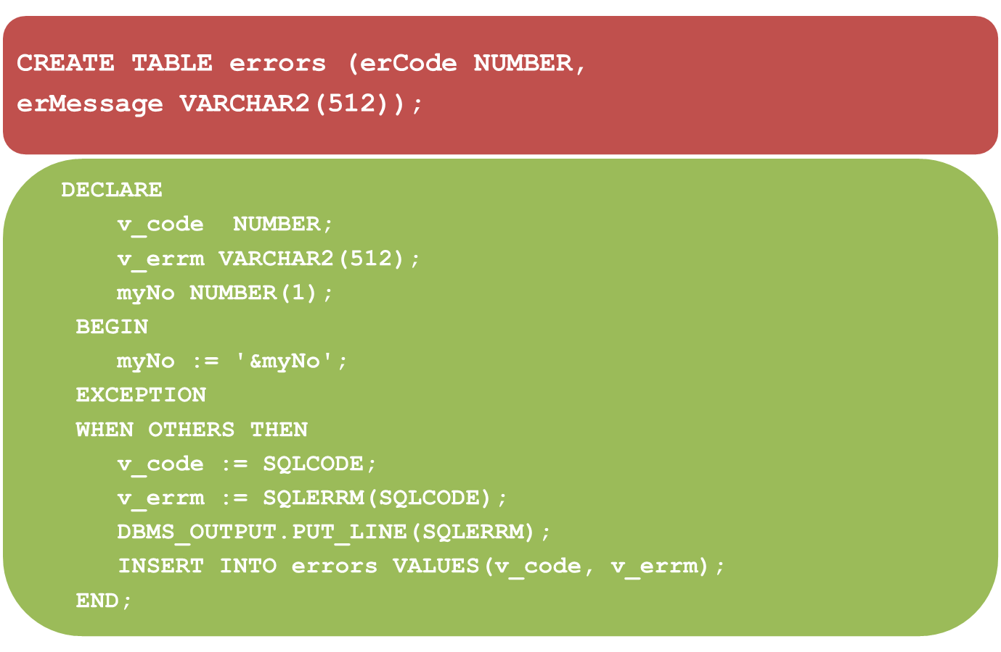
SQLCODE and SQLERRM: Example
Notes:
Maximum size of Oracle error message is 512 characters.
SQL> /
Enter value for myno: 45
old 6: myNo := '&myNo';
new 6: myNo := '45';
ORA-06502: PL/SQL: numeric or value error: number precision too large
PL/SQL procedure successfully completed.
SQL> /
Enter value for myno: Meenal
old 6: myNo := '&myNo';
new 6: myNo := 'Meenal';
ORA-06502: PL/SQL: numeric or value error: character to number conversion error
PL/SQL procedure successfully completed.
SELECT * FROM errors;
ERCODE ERMESSAGE
--------- ----------------------------------------------------------------------
-6502 ORA-06502: PL/SQL: numeric or value error: number precision too large
-6502 ORA-06502: PL/SQL: numeric or value error: character to number conversion error

Slide 21
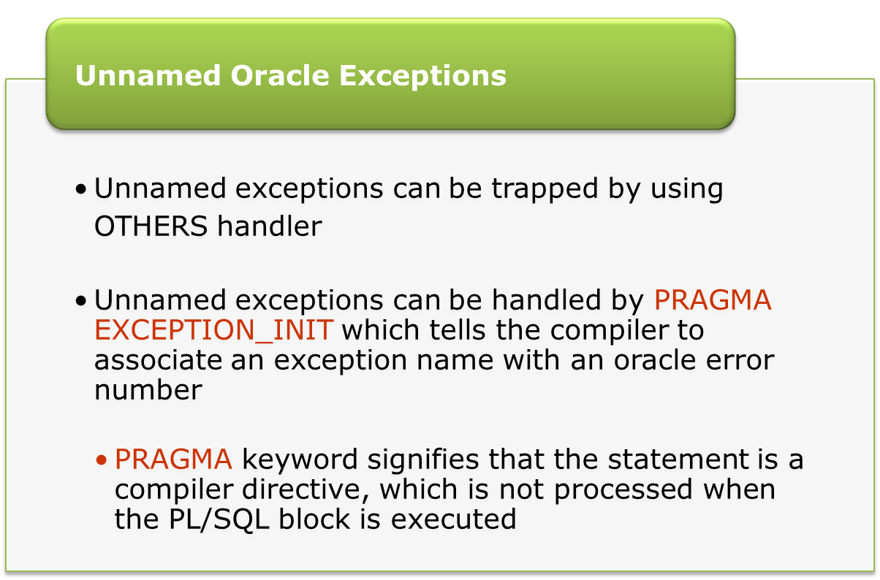
Exception Handling in PL/SQL

Slide 22
PRAGMA EXCEPTION_INIT: Example
DECLARE
e_serviceSubArea_exist EXCEPTION;
--Naming non-predefined oracle error
PRAGMA EXCEPTION_INIT(e_serviceSubArea_exist , -2292);
v_serv_area service_area.service_area_code%TYPE := &sa_no;
BEGIN
DELETE FROM service_area
WHERE service_area_code = v_serv_area;
COMMIT;
EXCEPTION
WHEN e_serviceSubArea_exist THEN
DBMS_OUTPUT.PUT_LINE('Can not delete service_area sub_area exist');
END;
Notes:
To demonstrate the working of the above program you have to verify that there is a primary key constraint on deptno column of dept table and referential integrity constraint on deptno column of the emp table with deptno column of dept table as its referenced column
For Oracle predefined exceptions the error numbers are negative except for NO_DATA_FOUND (+100). The error number for a specific oracle exception can be found from the oracle documentation
http://download.oracle.com/docs/cd/B19306_01/appdev.102/b14261/toc.htm
The error code -2292 given in above example, is for the exception that is fired by oracle when one is trying to delete a parent record that has child records. This exception does not have a name. So we can not write a separate handler for it as the handler syntax needs exception name. Hence in the above program we are associating a name with this Oracle exception using the PRAGMA EXCEPTION_INIT so that we can then write a separate handler for this exception using the name associated with it. However note that this name association is local and is limited only to the above code block.
we can also locally rename the predefined named exceptions to another name that may be more relevant for our program, using PRAGMA EXCEPTION_INIT

Slide 23

Exception Handling in PL/SQL
  Declared in the Declare Section with data type as EXCEPTION
  Raised Explicitly by using the RAISE keyword
  Handled in the Exception Section
  Local to a PL/SQL block
User-defined Exceptions
DECLARE
RAISE
HANDLE
Declarative Section
Executable Section
Exception Handling Section
Notes:
At times the application needs to implement some validations as per business rules. Now these are user imposed validations so would not give rise to Oracle error when violated. Similarly we may want to indicate to the user when the criteria specified in the WHERE condition of a DML statement is satisfied by none of the rows in the table. To incorporate these kind of validations that are not actual Oracle errors, PL/SQL lets you define exceptions of your own, raise those and handle the error accordingly.
Unlike Oracle exceptions, user-defined exceptions must be declared and must be raised explicitly by using RAISE statement.
e. g.
DECLARE
-- Declaring user defined exception
e_invalid_dept EXCEPTION;
BEGIN
UPDATE dept
SET dname = '&dname'
WHERE deptno = &deptno;
IF SQL%NOTFOUND THEN
--Raising user defined exception
RAISE e_invalid_dept;
END IF;
COMMIT;
EXCEPTION
--Handling user defined exception
WHEN e_invalid_dept THEN
DBMS_OUTPUT.PUT_LINE('Invalid department Number');
END;

Slide 24
User-defined Exception: Example
DECLARE
-- Declaring user defined exception
SR_check_status EXCEPTION;
v_SR_ID service_request.SR_ID%TYPE :=&SRID;
SR_Status Service_request.status%TYPE;
BEGIN
SELECT status INTO SR_status FROM service_request
WHERE sr_id=v_sr_id;
IF SR_Status ='pending' THEN
RAISE SR_CHECK_STATUS;
-- Raising user-defined exception
ELSE
DBMS_OUTPUT.PUT_LINE ('Service_request is not in pending status');
END IF;
EXCEPTION
--Handling user defined exception
WHEN SR_CHECK_STATUS THEN
DBMS_OUTPUT.PUT_LINE('Status Pending needs to be Attended Urgently');
WHEN OTHERS THEN
DBMS_OUTPUT.PUT_LINE(' Wrong input');
END;
Notes:
Consider the following business rule
Revised Company policy imposed the rule that the salary of employee should not be greater than his manager’s salary. It was decided that for the existing values the rule will not be applicable but for any further salary updates the rule should be implemented.
So for every update the above checking is done using the user defined exception e_check_Sal.
If any violation, then error message is given else the salary is updated.
In the above program we are dealing with only those employees that have a manager.

Slide 25
RAISE_APPLICATION_ERROR
A built-in Oracle procedure used to display the user-defined error messages along with the error number in the range -20000 and -20999.
Whenever RAISE_APPLICATION_ERROR is executed, all previous transactions which are not committed within the PL/SQL block are rolled back automatically (i.e. change due to INSERT, UPDATE, or DELETE statements).
This procedure is used for following reasons:
    To create a unique id for an user-defined exception.
    To make the user-defined exception look like an Oracle error.

Slide 26
RAISE_APPLICATION_ERROR
Syntax:
The error number must be between -20000 and -20999.
The error_message is the message you want to display when the error occurs.
  RAISE_APPLICATION_ERROR (error_number, error_message);
Notes:
Steps to be followed to use RAISE_APPLICATION_ERROR procedure:
Declare a user-defined exception in the declaration section.
Raise the user-defined exception based on a specific business rule in the execution section.
Finally, catch the exception and link the exception to a user-defined error number in RAISE_APPLICATION_ERROR.

Slide 27
RAISE_APPLICATION_ERROR
CREATE OR REPLACE PROCEDURE check_pending_status
(p_sr_id service_request.sr_id%TYPE)
Is
SR_Status Service_request.status%TYPE;
BEGIN
SELECT status INTO SR_status FROM service_request
WHERE sr_id=p_sr_id;
IF SR_Status ='pending' THEN
RAISE_application_error
(-20000, 'Status Pending… Need to be resolve urgently');
END IF;
END;

Slide 28
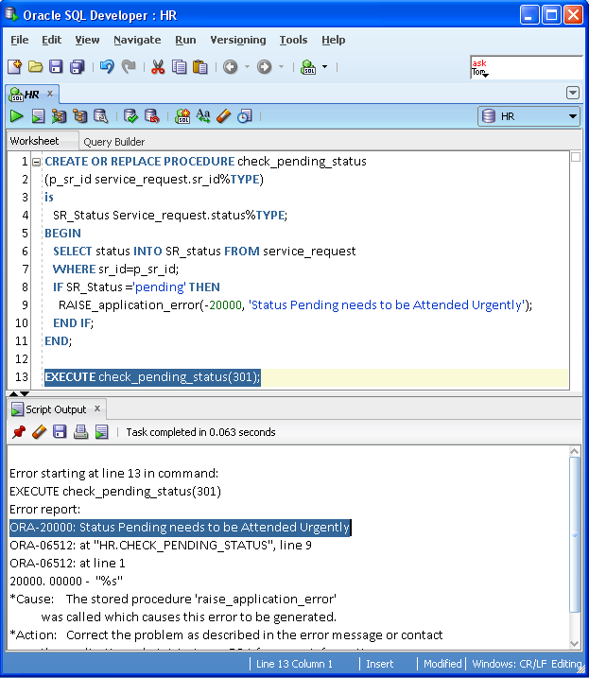
RAISE_APPLICATION_ERROR
This is how error message will get displayed:
RAISE_APPLICATION_ERROR raises an exception but does not handle it.

Slide 29
Handling User Defined Exception
Steps to handle User Defined Exception with error number:
    Declare user-defined exception
    Associate error number with user-defined exception through PRAGMA EXCEPTION_INIT
    Handle user-defined exception in EXCEPTION handling section

Slide 30
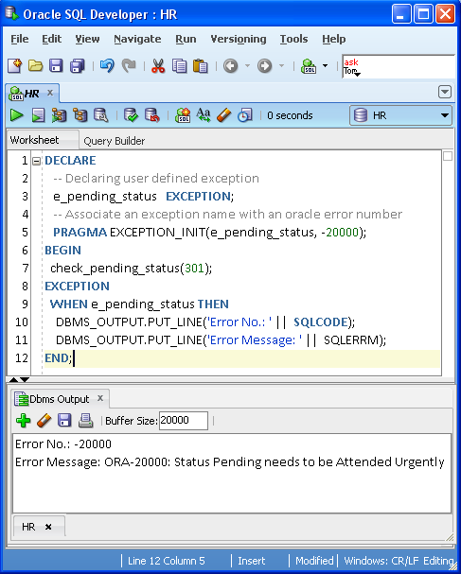
Handling User Defined Exception
Associated error number user-defined Exception
Error Handled at EXCEPTION Section
Output

Slide 31
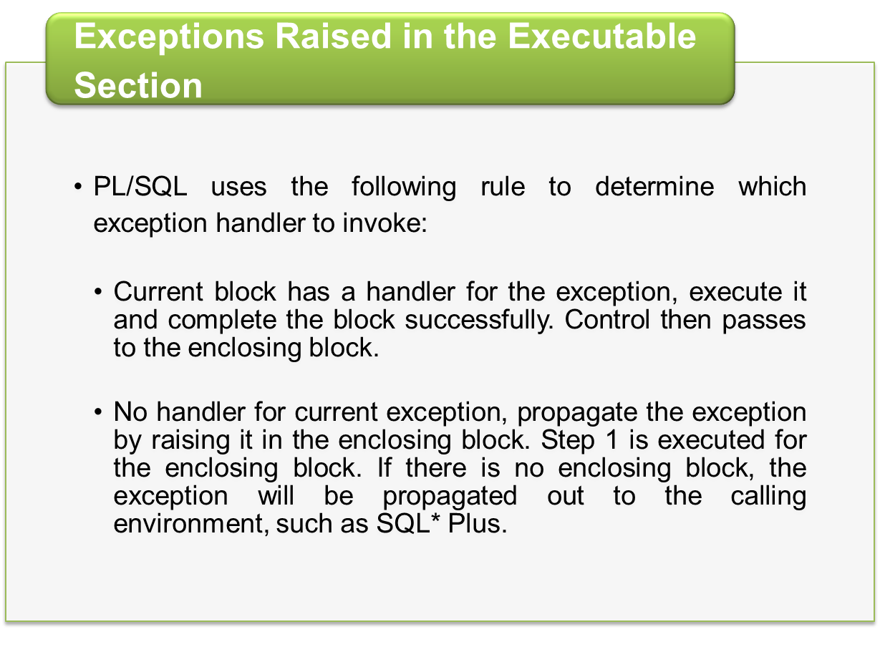
Exception Propagation

Slide 32
Exceptions Raised in the Executable Section: Example 1
DECLARE
A EXCEPTION;
BEGIN
BEGIN
RAISE A;
EXCEPTION
WHEN A THEN
. . .
END;
………..
END;
Exception A is raised in the inner block
A is handled in the inner block
Control resumes here

Slide 33
Exceptions Raised in the Executable Section: Example 2
DECLARE
A EXCEPTION;
B EXCEPTION;
BEGIN
BEGIN
RAISE B;
EXCEPTION
WHEN A THEN
. . .
END;
EXCEPTION
WHEN B THEN
. . .
END;
Exception B is raised in the inner block
No handler for exception B in the inner block
Exception B is propagated
to the enclosing block and
handle there
Control then passes out of
enclosing block, which completes
successfully

Slide 34
Exceptions Raised in Declarative Section: Example 1
DECLARE
v_number NUMBER(3):=‘ABC’;
BEGIN
. . .
EXCEPTION
WHEN OTHERS THEN
. . .
END;
Illegal assignment raises VALUE_ERROR
Even though there is a WHEN OTHERS handler, it is not executed
The block completes unsuccessfully with the VALUE_ERROR exception

Slide 35
Exceptions Raised in Declarative Section: Example 2
Illegal assignment raises VALUE_ERROR
BEGIN
DECLARE
v_number NUMBER(3):=‘ABC’;
BEGIN
. . .
EXCEPTION
WHEN OTHERS THEN
. . .
END;
EXCEPTION
WHEN OTHERS THEN
. . .
END;
Even though there is an OTHERS handler for the inner block, it is not executed
The exception handler in the outer block handles the exception
Control then passes out of enclosing block which completes successfully

Slide 36
Exceptions Raised in Exception Section: Example 1
DECLARE
A EXCEPTION;
B EXCEPTION;
BEGIN
RAISE A;
EXCEPTION
WHEN A THEN
RAISE B;
WHEN B THEN
. . .
END;
Exception A is raised
Exception A is handled and B is raised in A’s handler
Even though there is a handler for B here, it is not executed. The exception is propagated out of the block
The block completes unsuccessfully with unhandled exception B

Slide 37
Best practices for Error Management
Application code must raise, handle, log and communicate errors in a consistent, robust manner
Compensate for PL/SQL weaknesses
Some general guidelines:
    Avoid hard-coding error numbers and messages
    Build and use reusable components for raising, handling and logging errors
  PRAGMA EXCEPTION_INIT: Avoid duplication of error definitions
WHEN OTHERS THEN
IF SQLCODE = -24381 THEN...
ELSIF SQLCODE = -1855 THEN...
Notes:
Compensate for PL/SQL weaknesses-
1) Difficult to ensure execution of common error handling logic.
Usually end up with lots of repetition.
No "finally" section available in PL/SQL - yet.
2) The EXCEPTION data type does not allow you to store the full set of information about an error.
What was the context in which the error occurred?
3) Restrictions on how you can specify the error
Only 1000 for application-specific errors....
Avoid hard-coding of error numbers and messages-
If every developer writes exception handler code on their own, you end up with an unmanageable situation.
Different logging mechanisms, no standards for messages, inconsistent handling of same errors, etc.
In Summary
Make sure you understand how it all works
Exception handling is tricky stuff
Set standards before you start coding
It's not the kind of thing you can easily add in later
Use standard infrastructure components
Everyone and all programs need to handle errors the same way
Don't accept the limitations of Oracle's current implementation.
You can do lots to improve the situation.

Slide 38
Summary
In this session, we have covered,
    Terms: Exceptions and Exception handling
    Predefined exceptions
    User-defined exceptions
    Rules for Exception Propagation
    Best Practices for Error Management

Slide 39
Thank You

